Slide 1
Enhancing the Web Application
Software Quality Systems
Team 6
Dylan Jenkins
Binod Katawal
Jake Davis
Manni Mashaee
CS 499 – 002
Fall 2017
12/06/2017

Slide 2

Outline
Software Quality Systems
The Web Application
Required Features Added
System Build
Demo
Twist
Testing & Challenges
Questions

Slide 3

Software Quality Systems

Slide 4
The Web Application
By default, users see a fully functioning website.
SQS creates erroneous versions of all of the features on the web application.
Users are assigned these errors and the task of fixing them.
Database tracks each of the errors assigned.
Users without errors show how accounts should normally work.

Slide 5

Progress Bar

Slide 6
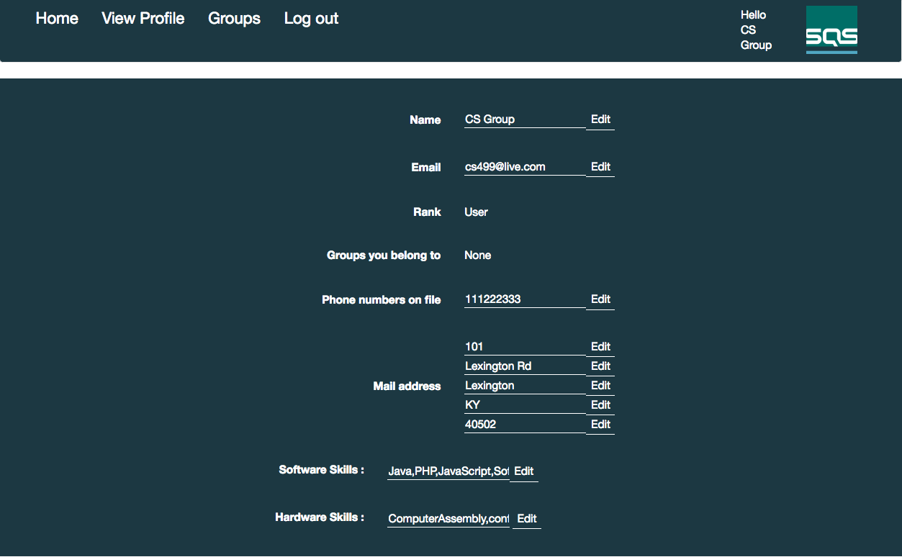
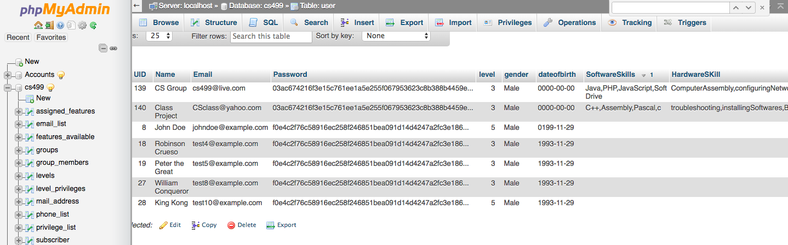
Skills Bank

Slide 7
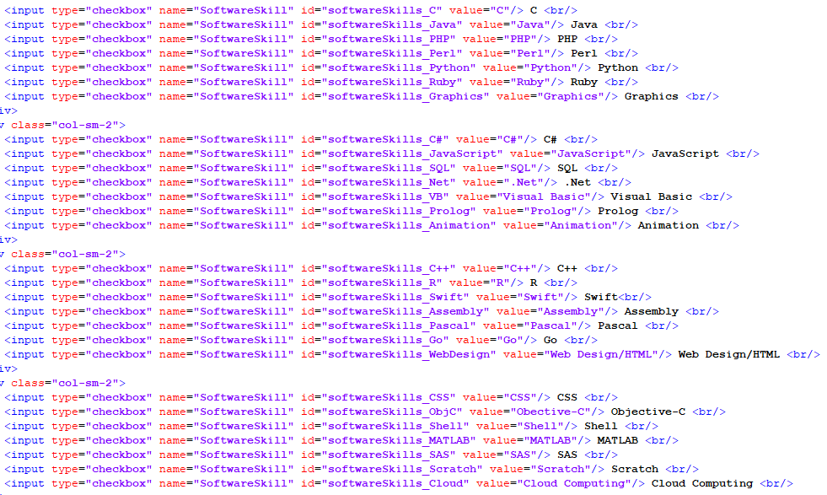
Element ID Tags

Slide 8


System Build

Slide 9
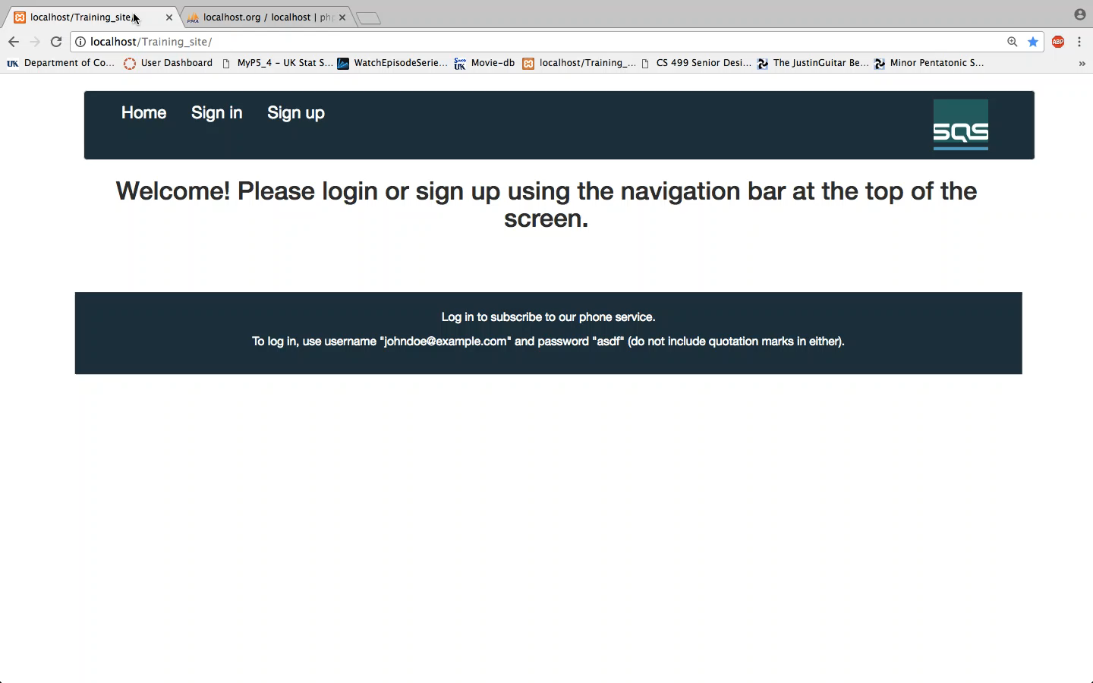

Slide 10
The Twist

Slide 11

Testing & Challenges

Slide 12
Questions?

